Slide 1

Framing & Composition Stills
Vivienne COokmeyer

Slide 2
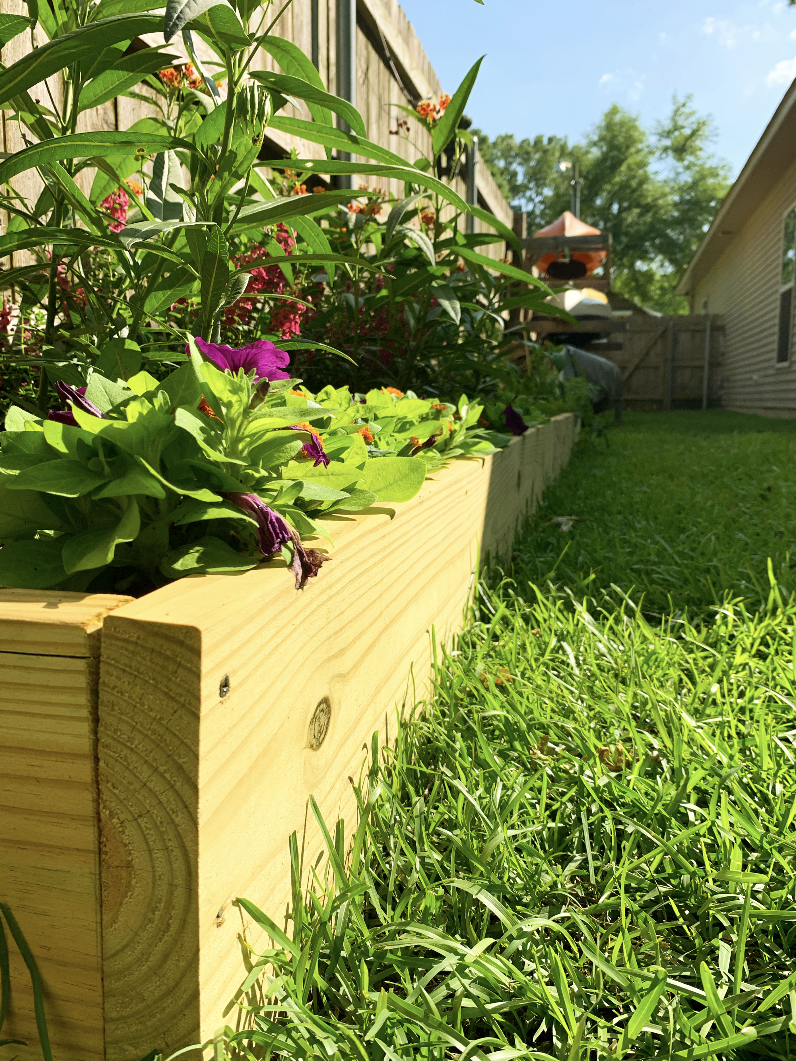
Title: Box Garden
Photo By: Vivienne Cookmeyer
Composition Principle: Framing with an Edge 1

Slide 3
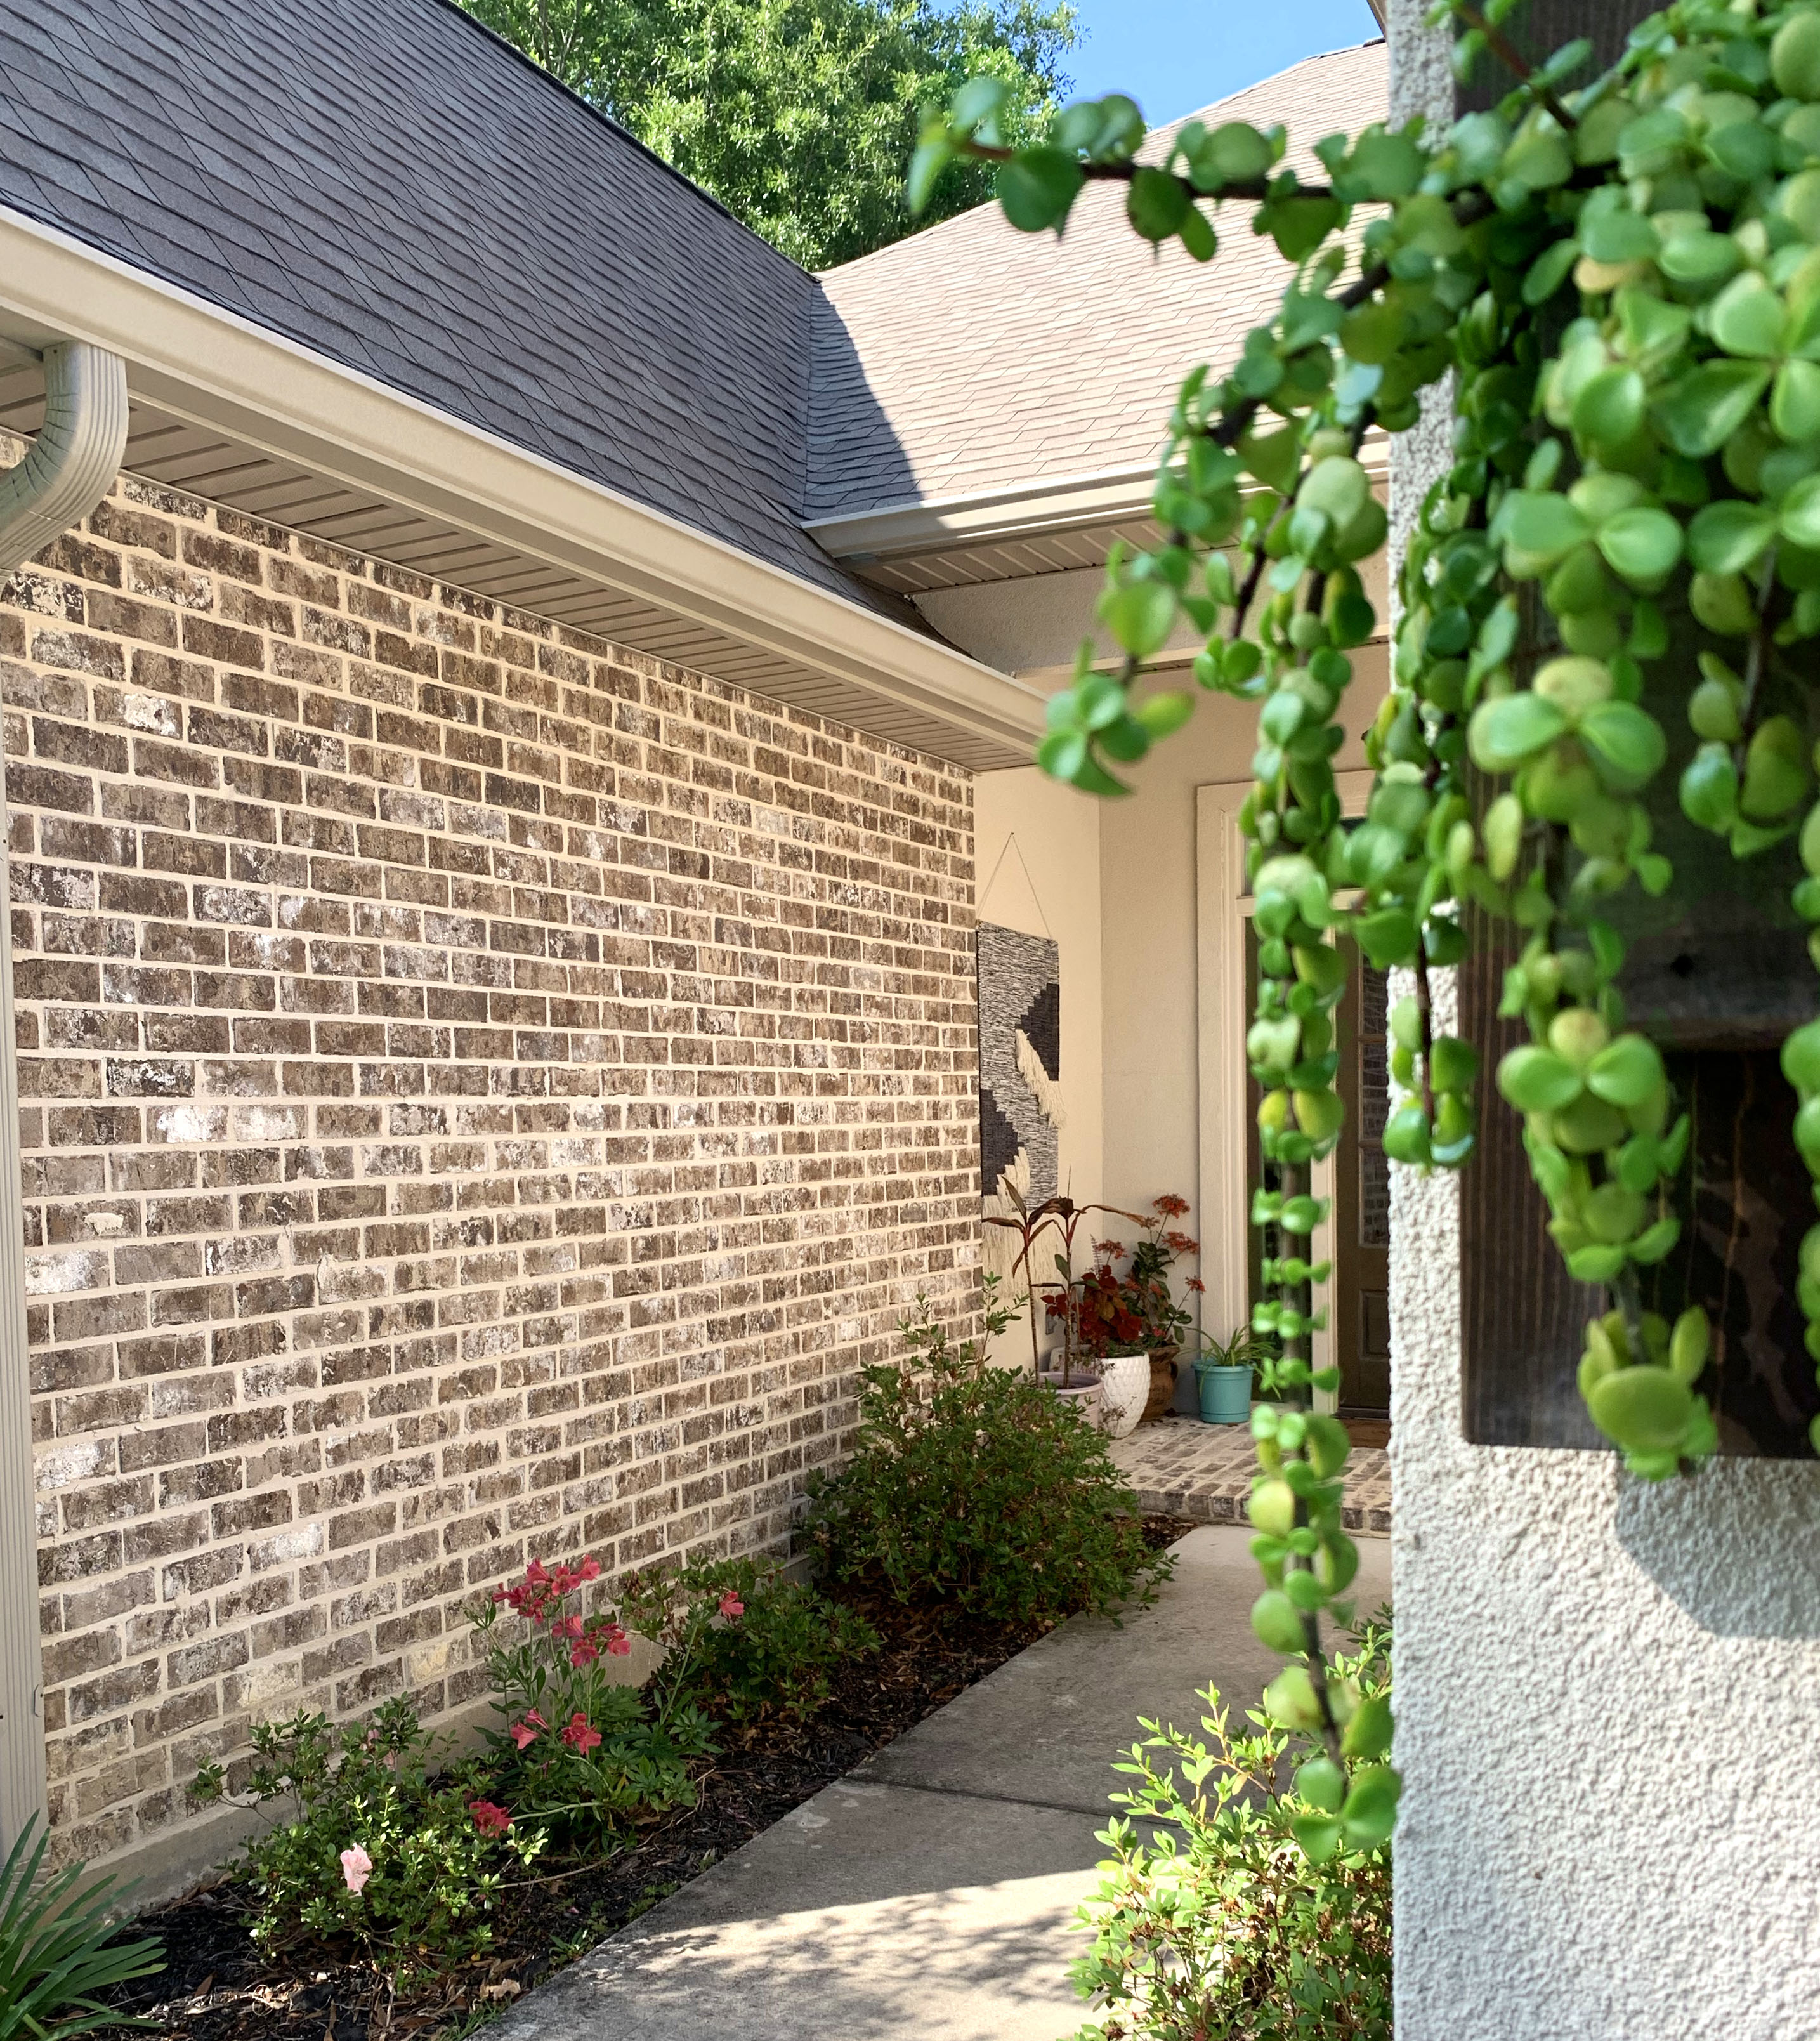
Title: Spring Home
Photo By: Vivienne Cookmeyer
Composition Principle: Framing with an Edge 2

Slide 4
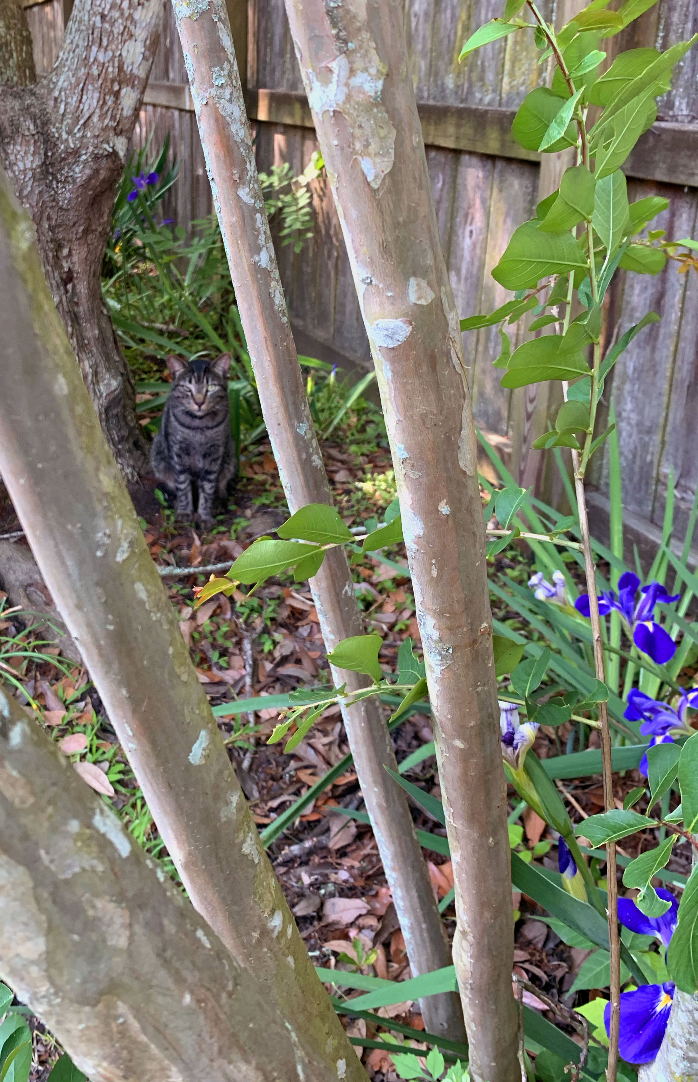
Title: Camouflage Cat
Photo By: Vivienne Cookmeyer
Composition Principle: Frame within a Frame 1

Slide 5
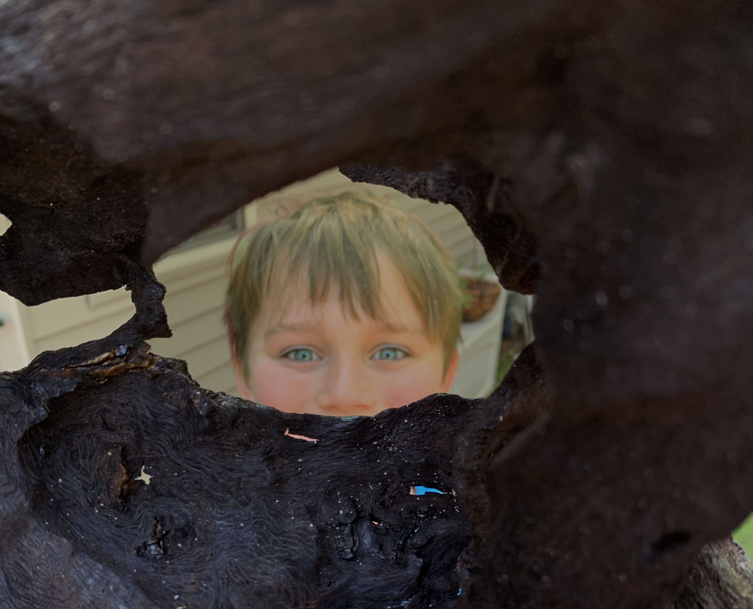
Title: Curious Boy
Photo By: Vivienne Cookmeyer
Composition Principle: Frame within a Frame 2

Slide 6
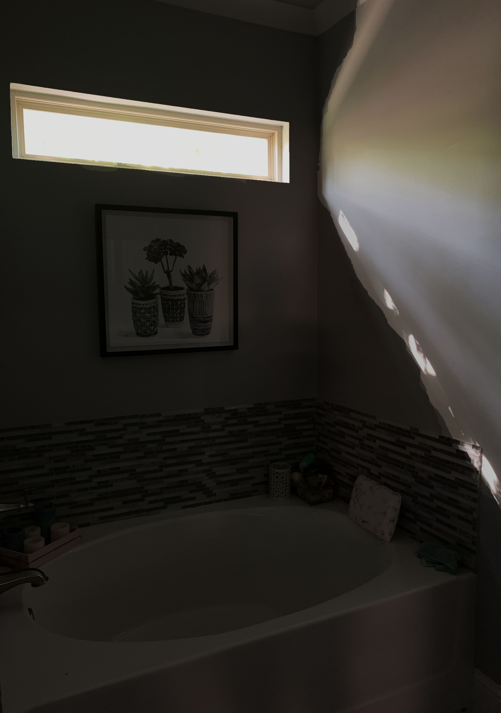
Title: Bath Time
Photo By: Vivienne Cookmeyer
Composition Principle: Dominant Contrast 1- Light vs. Dark

Slide 7
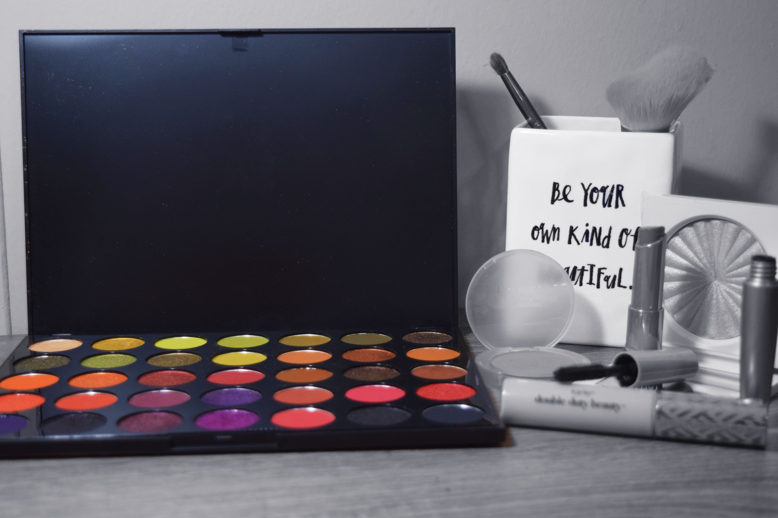
Title: Makeup
Photo By: Vivienne Cookmeyer
Composition Principle: Dominant Constrast 2- Black & White vs. Color

Slide 8
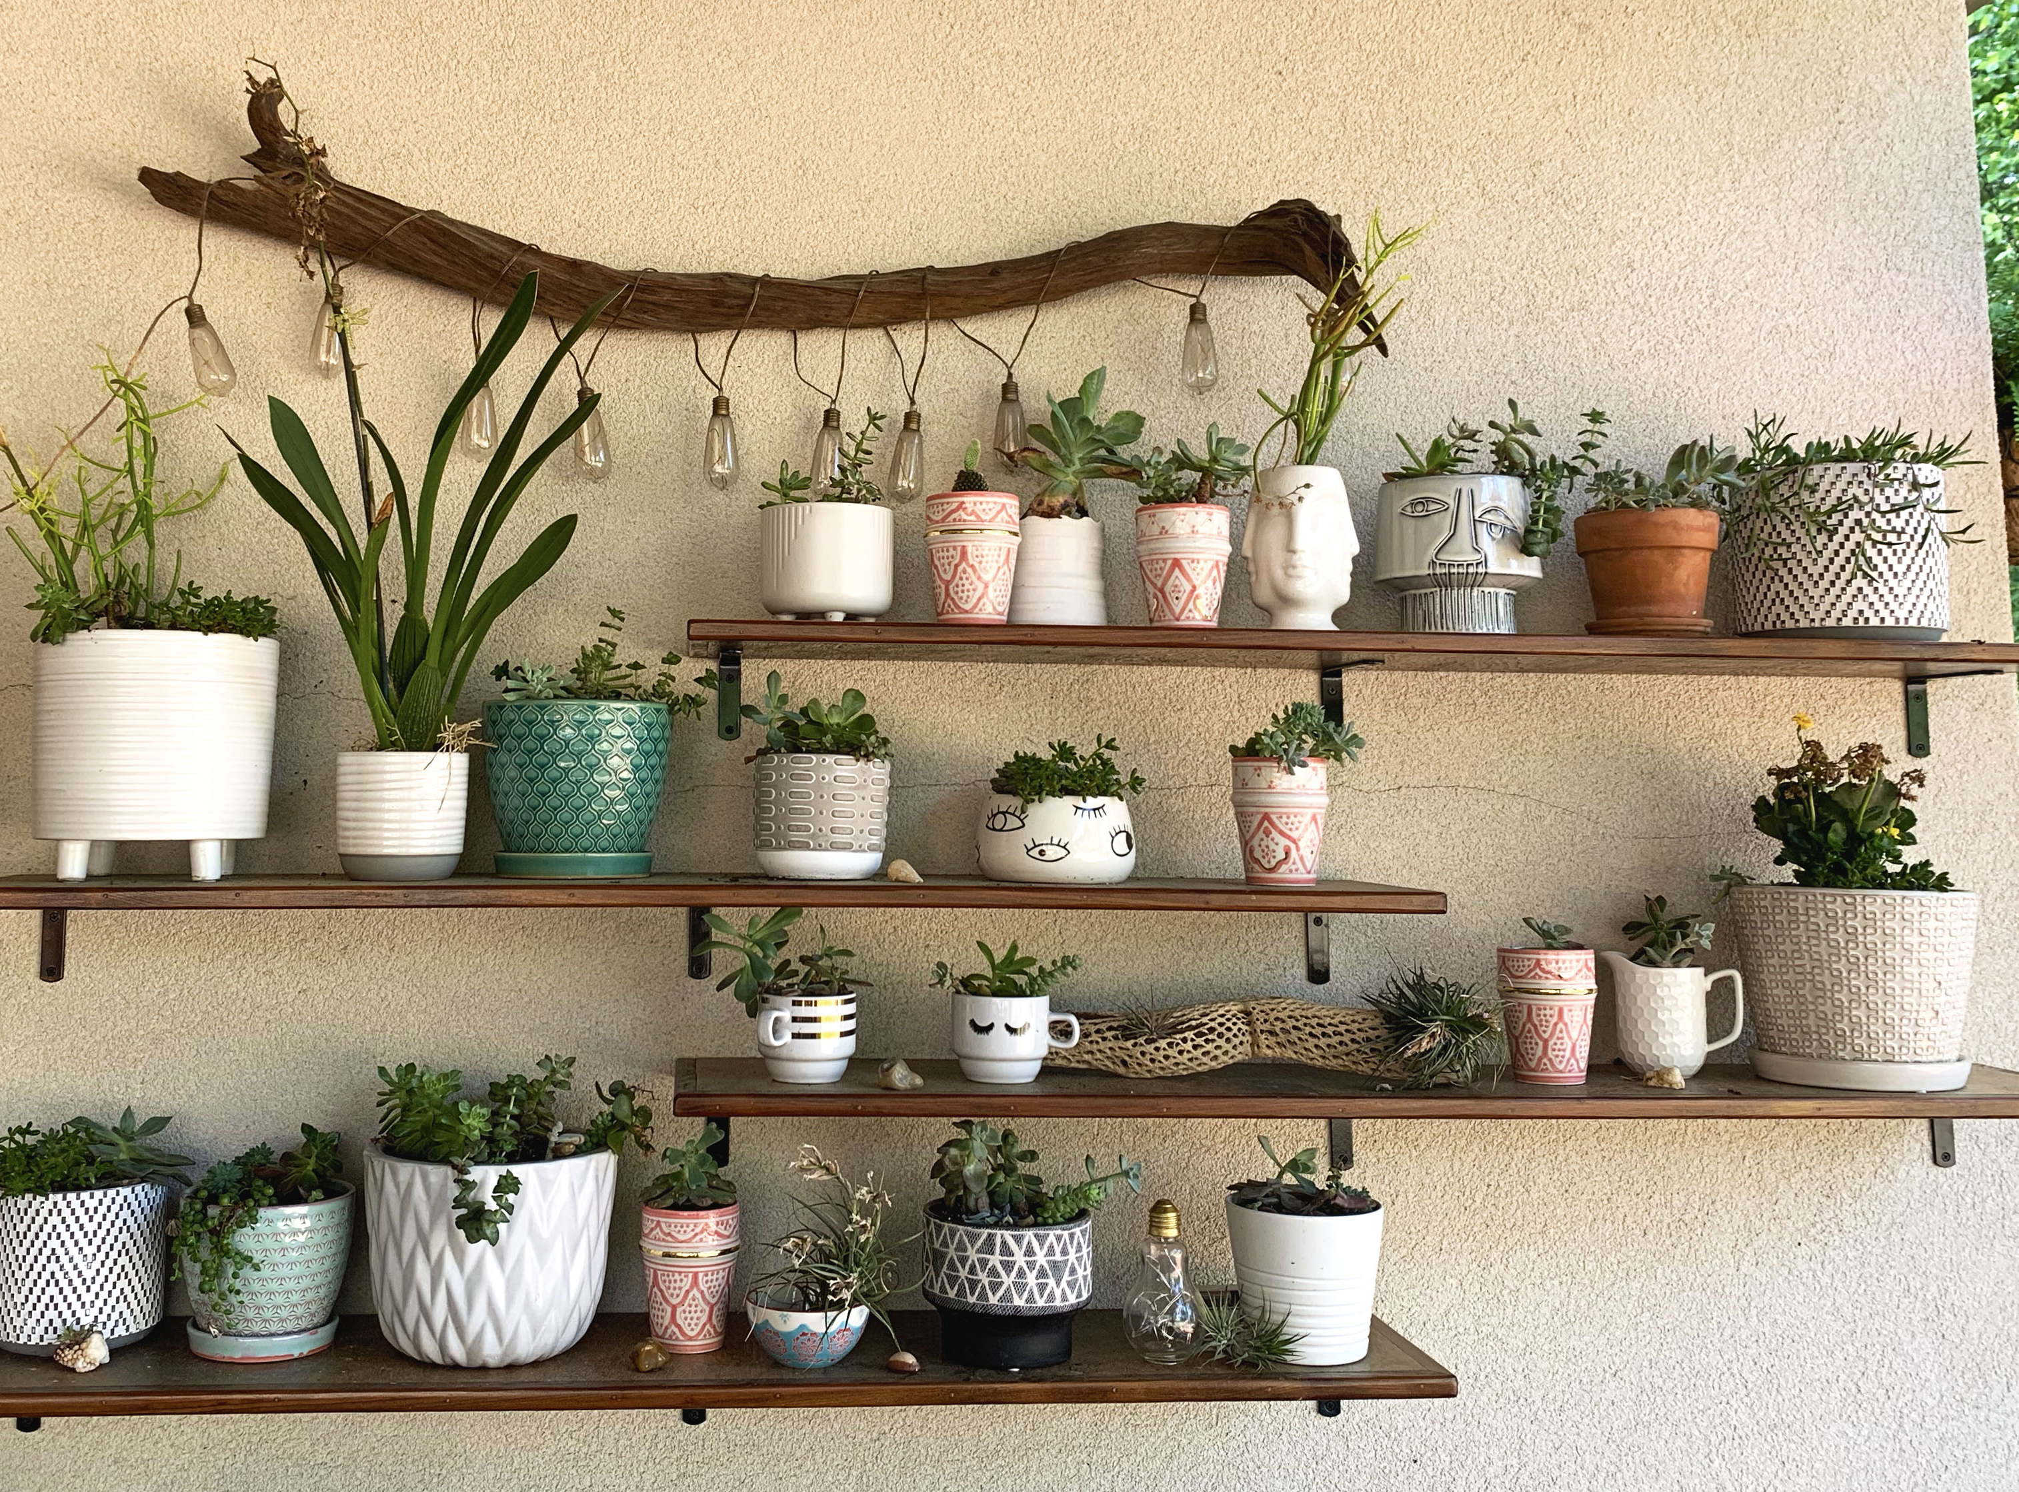
Title: Succulent Shelves
Photo By: Vivienne Cookmeyer
Composition Principle: Directional Lines 1

Slide 9
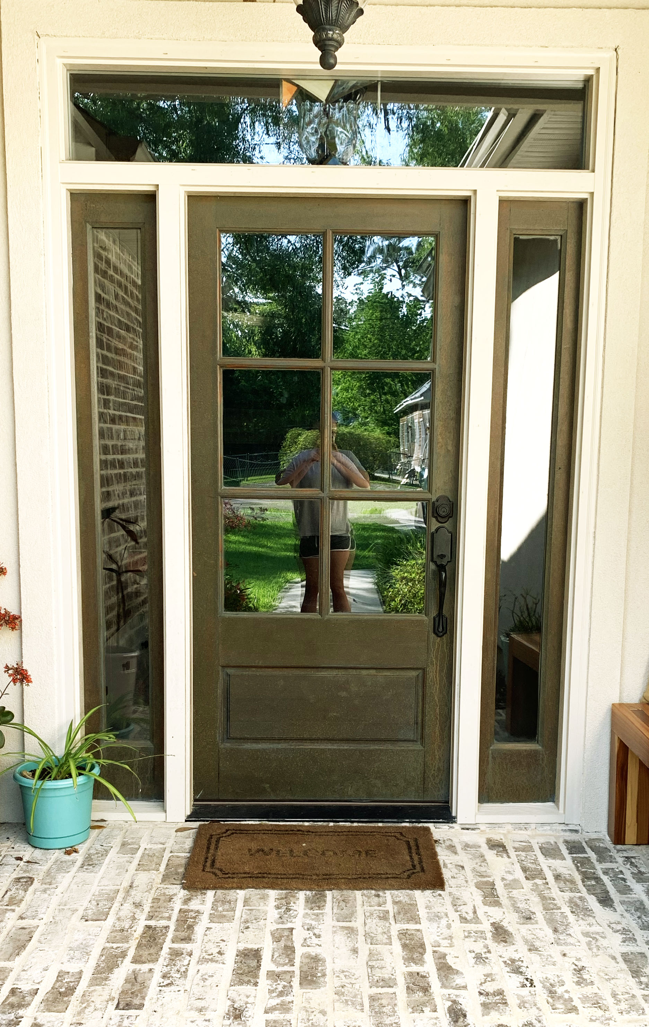
Title: Welcome
Photo By: Vivienne Cookmeyer
Composition Principle: Symmetry 1

Slide 10
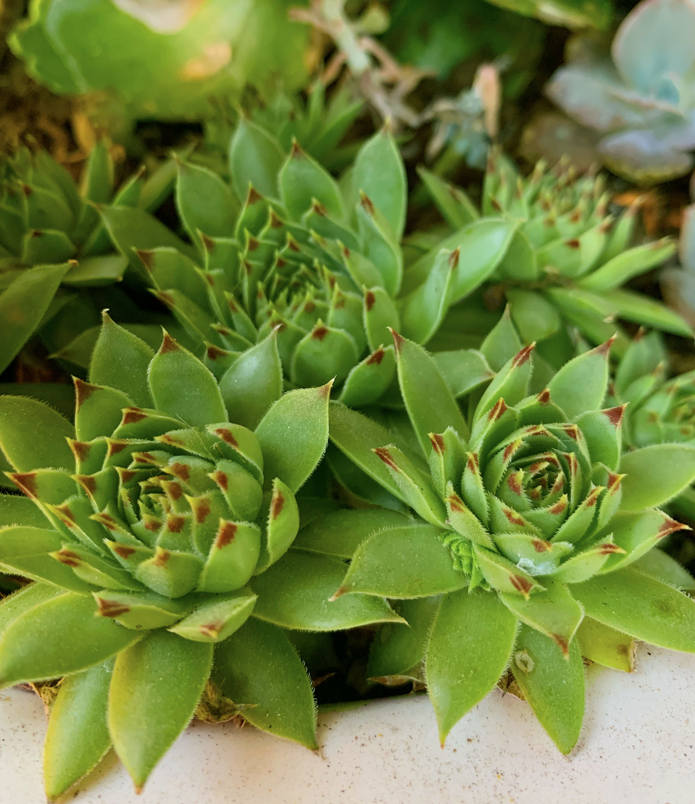
Title: Baby Succulents
Photo By: Vivienne Cookmeyer
Composition Principle: Macro/Texture 1

Slide 11
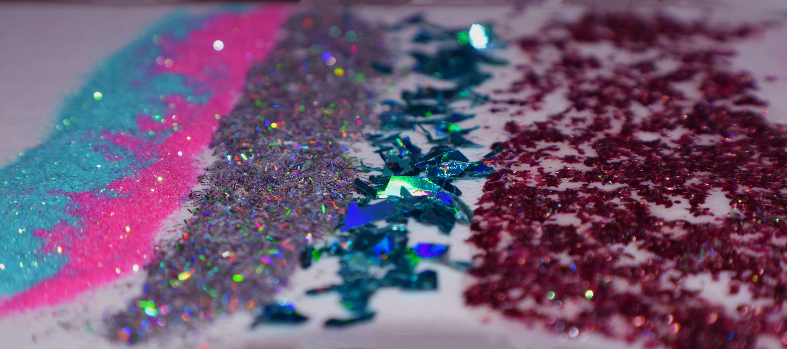
Title: Shimmer and Shine
Photo By: Vivienne Cookmeyer
Composition Principle: Macro/Texture 2

Slide 12
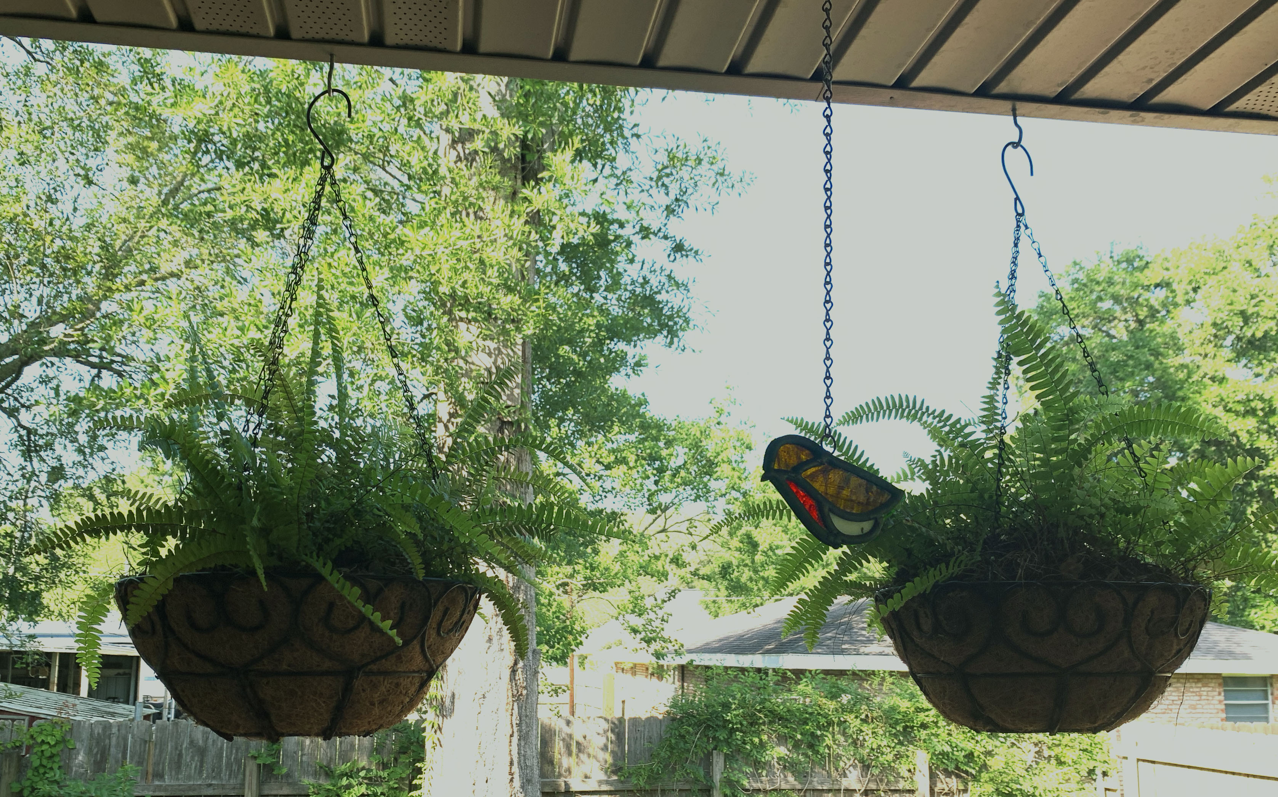
Title: Robin
Photo By: Vivienne Cookmeyer
Composition Principle: Rule of Thirds 1

Slide 13
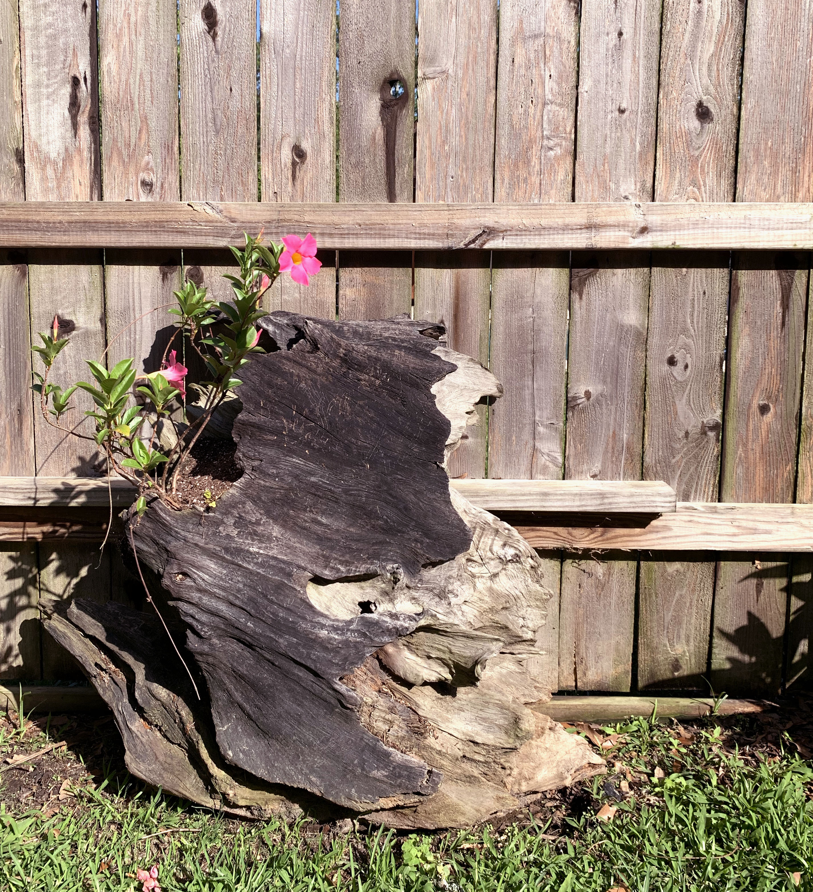
Title: Flower Adrift
Photo By: Vivienne Cookmeyer
Composition Principle: Rule of Thirds 2

